Slide 1

Predicting Housing Prices
Ryan Janson

Slide 2

Data Pre-Processing

Slide 3
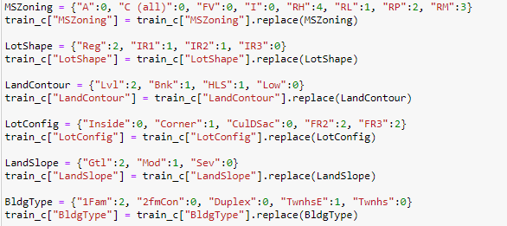
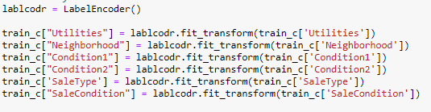
Start Label Encoding
We took advantage of the python dictionary to create key value pairs that assigned numerical values to categorical variables.
For less obvious categorical data, we used scikitlearn’s label encoder

Slide 4
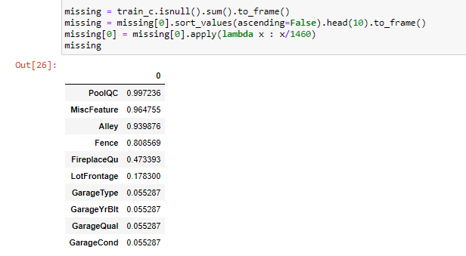
Missing Value Replacement
We removed features with over 80% of the data missing.
RATIONALE: Imputing over 80% of the data with the same value will result in a feature with low variance and will no longer be informative to the model.

Slide 5
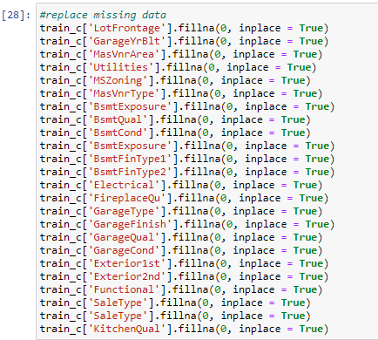
Missing Value Replacement
Replaced remaining Null values with 0.
0 is an appropriate numerical replacement, because the missing data on these features indicate the feature not being part of the house’s construction.
Imputing the missing data with the mean or median of the dataset would therefore throw the model off.

Slide 6

Exploratory Data Analysis

Slide 7
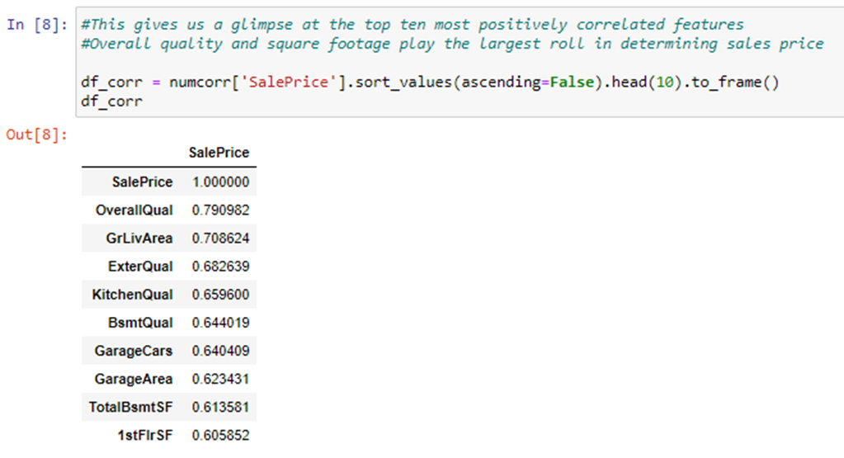
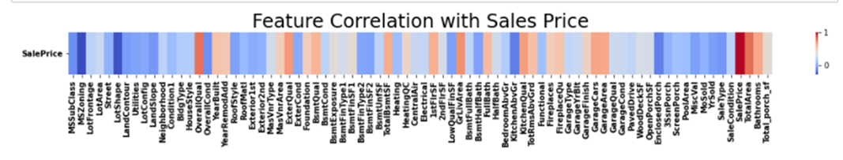
Examine Correlation
We examined the correlation between each feature and the target variable “SalesPrice” using a heatmap.
For simplicity, we decided to examine the top ten most correlated features in detail

Slide 8
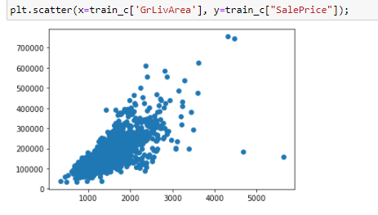
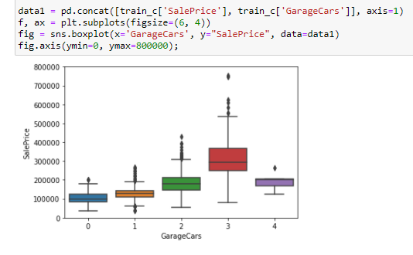
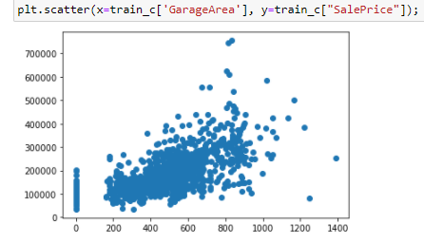
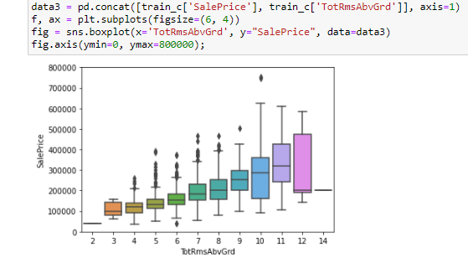
Removing Outliers

Slide 9
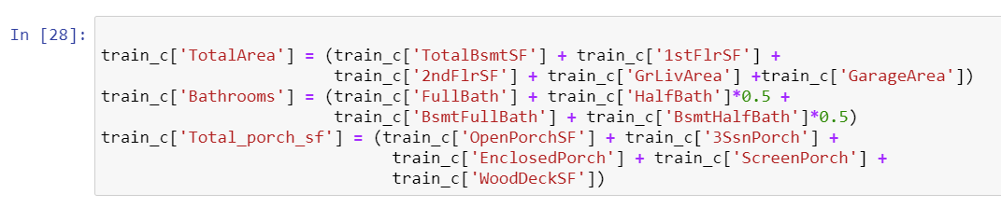
Feature Engineered Variables

Slide 10

Run Regression Models

Slide 11
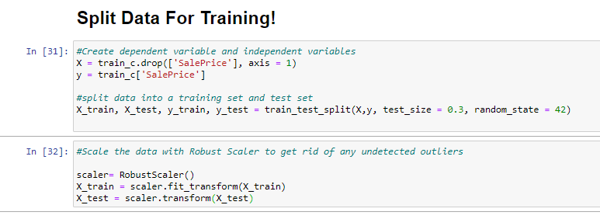
Split and Scale Data for Training

Slide 12
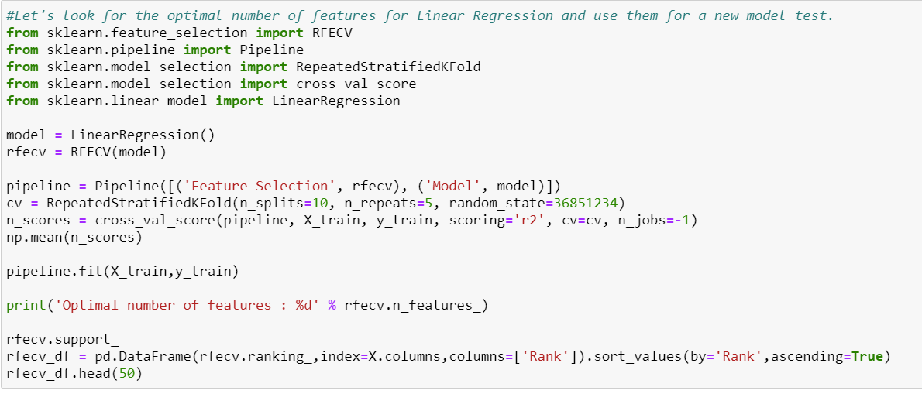
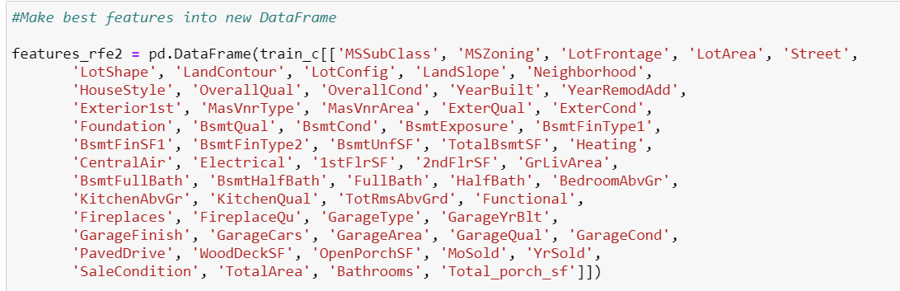
Feature Selection
We used Recursive Feature Elimination to help us select the most relevant features.
RFE ranks features by importance with repeated k-fold cross-validation
The RFE model returned 62 optimal features, which we used to created a new dataframe to train our regression models.

Slide 13
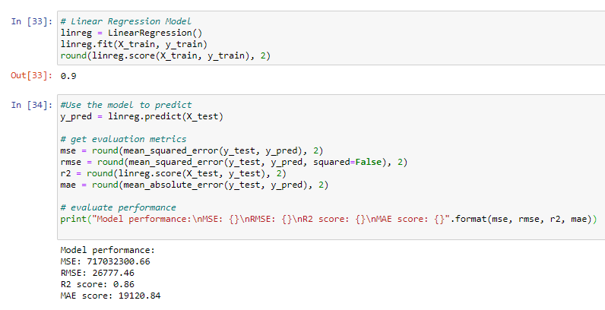
Run a Few Regression ModelS

Slide 14

Actually, a lot of regression models
Linear
Logistic
Lasso
Ridge
Elastic Net
Random Forest
Decision Tree

Slide 15

XGBoost
XGBoost (eXtreme Gradient Boosting) is a model based on gradient boosted decision trees
XGBoost takes an iterative approach. It combines many models together by boosting each in succession, with each new model being trained to correct the mistakes of the previous one

Slide 16
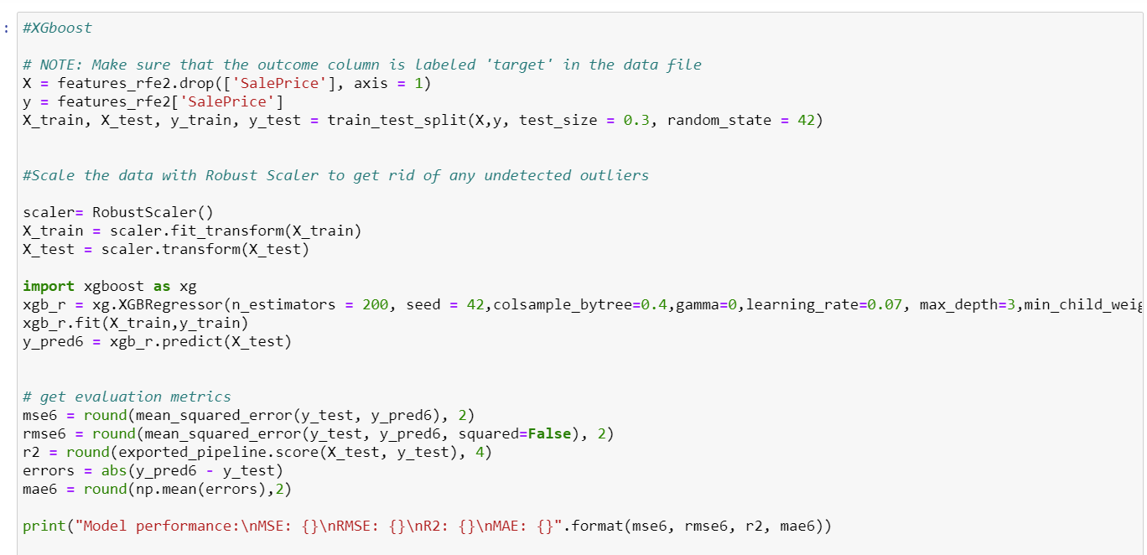
Instantiate XGBoost

Slide 17
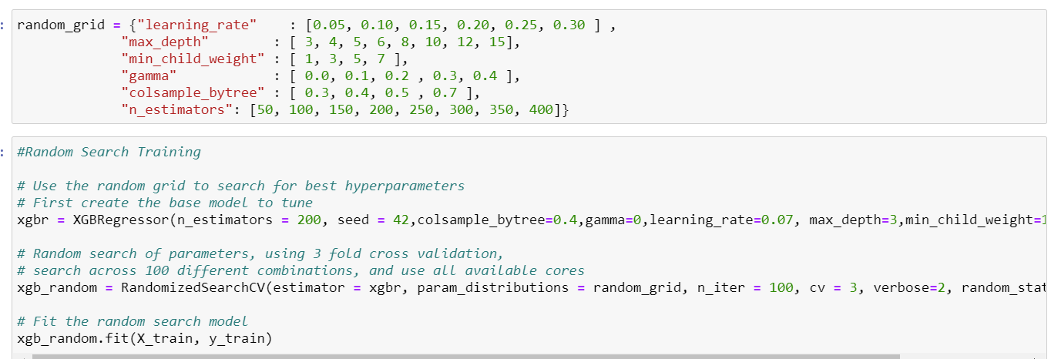
Tune Hyperparameters

Slide 18
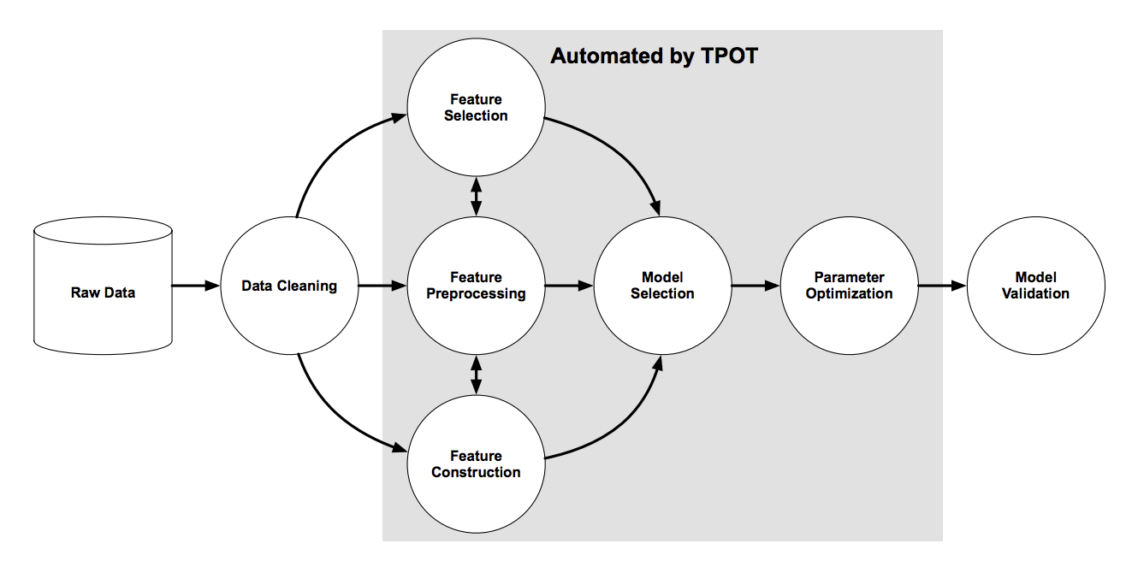
TPOT Method
Tree Based Optimizations Pipeline Tool
A for loop runs multiple models and examines the best combinations of hyperparameters for each model. Once the best model and parameters are determined, TPOT will return the pipeline in a separate .py file

Slide 19

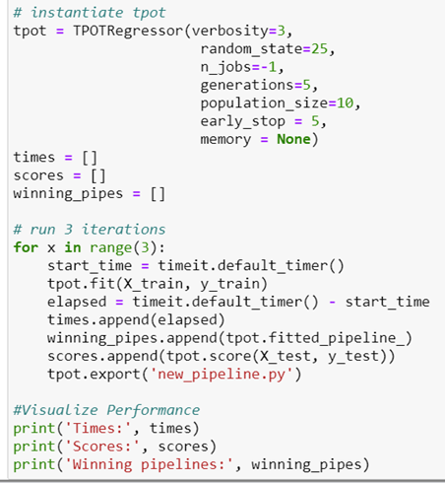
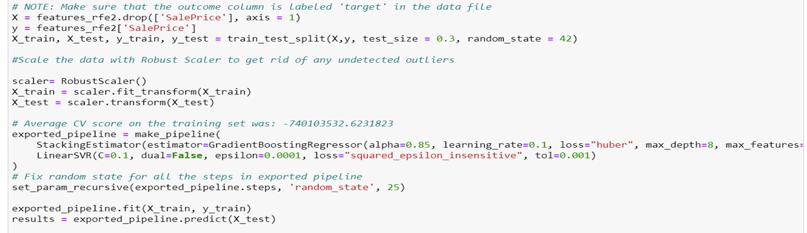
Running TPOT

Slide 20
Picking the Winning Model
TPOT MAE: 23,234.6; Accuracy: 85.4727%
XGBoost MAE: 14,306.2366; Accuracy: 91.20%

Slide 21



Run and Validate Winning Model
Saved and imported the XGBoost Model to our testing notebook.
Ran the test.csv file through all of the pre-processing steps we used for the train model
Predicted the Sales Price with the train.csv file

Slide 22


Leftover Wonderings

Slide 23
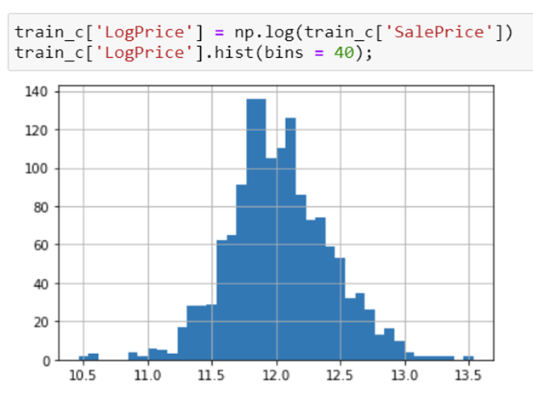
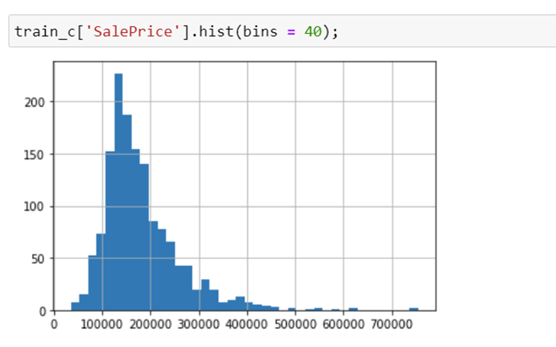
Adjusting the Skewness of Sales Price

Slide 24
Voting Regressor
We also used a Voting Regressor with our train and test data.
A voting regressor is an ensemble method that combines several models to work together on a single set of data
While the initial scoring on the train dataset was similar to that of the TPOT and XGBoost models, the MAPE score received on the test dataset was suspiciously low.
MAPE Score: 0.09

